Slide 1
Stroke Prediction
Our Team:
Luke Awino, Emina Belekanich, Angela Zhang
GitHub link: https://github.com/EBelekanich/Stroke-Prediction

Slide 2

Purpose
Strokes are a leading cause of long-term disability and death
Every 40 seconds, someone suffers from a stroke in the U.S
Understanding risk factors can help with prevention and awareness
Distinguish high risk patients
Catching early symptoms can mitigate long-lasting effects
Predict chances of having a stroke

Slide 3
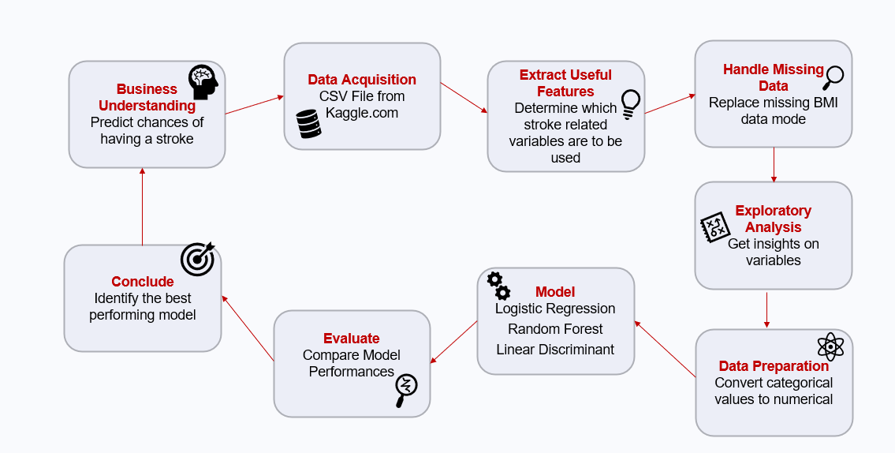
Project Life Cycle

Slide 4
Data Source and Variables
Project data was obtained from Kaggle.com
Original file type was Comma Separated File (CSV)
The data contains 5110 observations with 12 attributes.
Each row in the data set provides relevant information about the patient

Slide 5
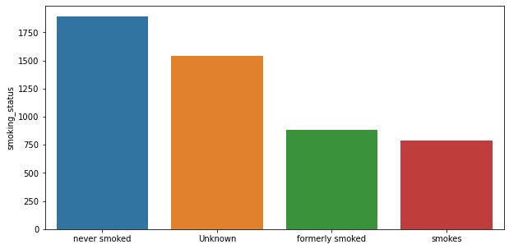
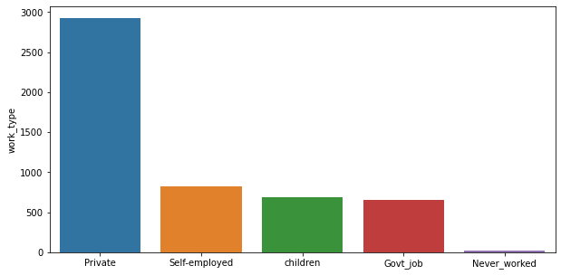
Insights From Original Data Set
Notes:
Here are Some of the iinsights from the dataset
Lets look at the lifestyle variables smoking and work-type
-smoking majority of the dataset never smoked
-we have unknowns , formerly smoked and smokes
-looking at the work type variable
Significant part of the population have some type of employment and a very small percentage has never worked

Slide 6
Exploratory Data Analysis
Data Pre-Processing
Obtaining Statistics
Replacing Missing Values
Removing Unnecessary Variables
Training and Testing Data Split
60/40 Ratio
Random State Selection
Notes:
During the eda the data was cleaned
-missing values replaced,
Feature engineering Blood sugar converted to low , normal, borderline high
-the lifestyle variables were removed leaving the health variables
The Data was split into training and test sets

Slide 7
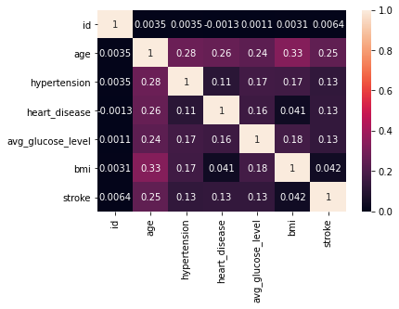
Exploratory Data Analysis
Notes:
-after removing the lifestyle variables
-correlation between the health variables is there one that has a greater impact?
-none of the health variables has significant correlation with increased stroke chances

Slide 8
Modeling
Features used:
Gender, Age, Hypertension, Heart Disease, BMI, Smoking history and Blood Sugar Level
Classification models used to address the problem:
Logistic Regression
Random Forest
Linear Discriminant Analysis
Naïve Bayes

Slide 9
Model Evaluations
Evaluation Measure | Logistic Regression | Random Forest | Linear Discriminant Analysis | Naive Bayes
Precision | .9441 | .9223 | .9303 | .9358
Recall | .7265 | .9447 | .9506 | .8674
F1 Measure | .8042 | .9306 | .9329 | .8955
Notes:
For logistic regression used the balanced model

Slide 10

Conclusion
Patient data can be collected for stroke prediction
An accurate prediction saves lives and assists with well-informed recommendations
F-1 score is used to measure model performance
Harmonic mean of precision and recall
LDA model performs best given the set of selected features

